Slide 1
Searching
Finding Items in Sequences
Sequences / Lecture 4
Franck Chauvel
Go to www.menti.com
use the code 89 05 90 0
Axbit & NTNU
franck.chauvel@ntnu.no

Slide 2
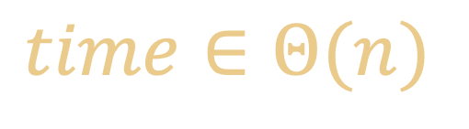
Recall the “Linear Search”
Find “67”
no
yes
no
no
no
no
no
no
0
1
2
3
4
5
6
7
8
9
10
11
23
35
8
11
213
86
37
67
55
54
27
39
$$time∈Θ(n)$$

Slide 3

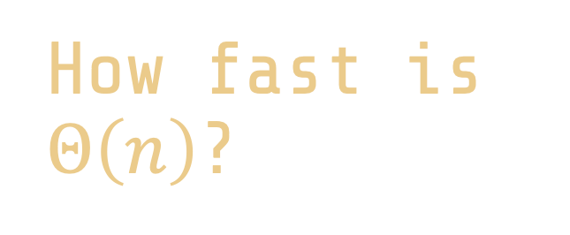
How fast is $Θ\left(n\right)$?
Image by Extravis_Marketing from Pixabay
English dictionary
1 word per second
250 000 words
34 hours
500 000 words
3 days

Slide 4

Searching
Photo by Annie Theby on Unsplash
Linear Search
Jump Search
Binary Search
Interpolated Search
Recap

Slide 5
How Could we Do Better?
What would you try?

Slide 6

Order
Know where to search
We need an “ordering”

Slide 7
Sorted Arrays
0
1
2
3
4
5
6
7
8
9
10
11
23
35
8
11
213
86
37
67
55
54
27
39
0
1
2
3
4
5
6
7
8
9
10
11
8
11
23
27
35
37
39
54
55
67
86
213
smaller
larger

Slide 8
Why?
Find “67”
35 < 67
0
1
2
3
4
5
6
7
8
9
10
11
8
11
23
27
35
37
39
54
55
67
86
213
smaller
larger

Slide 9

2.Jump Search
A first alternative to linear search
Image by andreas N from Pixabay

Slide 10
Jump Search
Jump size: 4
Find “67”
smaller!
smaller!
bigger!
0
1
2
3
4
5
6
7
8
9
10
11
8
11
23
27
35
37
39
54
55
67
86
213
smaller
larger

Slide 11
What Jump Size?
n items
0
1
2
3
4
5
6
7
8
9
10
11
8
11
23
27
35
37
39
54
55
67
86
213
jump k items

Slide 12
Jump Search
function jumpSearch(array, value) {
const jump = Math.floor(Math.sqrt(array.length));
let current = 0;
while (current < array.length && array[current] < value) {
current += jump;
}
if (current >= array.length) return -1;
if (array[current] === value) return current;
return linearSearch(array, value, current-jump);
}

Slide 13

How much better is $Θ(\sqrt{n})$?
Image by Extravis_Marketing from Pixabay
English dictionary
1 word per second
250 000 words
5 minutes
500 000 words
8 minutes

Slide 14

3.Binary Search
How to do even better …
Photo by samer daboul from Pexels

Slide 15
Binary Search
Find “67”
27 < 67
54 < 67
Found
86 > 67
0
1
2
3
4
5
6
7
8
9
10
11
8
11
23
27
35
37
39
54
55
67
86
213
1st pick
3rd pick
2nd pick
smaller
larger

Slide 16
Where Shall we Chop?
Little progress and likely
27 < 67
0
1
2
3
4
5
6
7
8
9
10
11
8
11
23
27
35
37
39
54
55
67
86
213
Much progress
but unlikely

Slide 17
Binary Search—Code
function binarySearch(array, value) {
let lower = 0;
let upper = array.length;
while (upper-lower > 1) {
let split = lower + Math.floor((upper-lower)/2);
if (array[split] > value) {
upper = split - 1;
} else if ( array[split] < value) {
lower = split + 1;
} else {
return split;
}
}
return -1;
}

Slide 18
How Fast is It?
1st split
Log₂ n
2nd split
2nd split
3rd
3rd
3rd
3rd
0
1
2
3
4
5
6
7
8
9
10
11
8
11
23
27
35
37
39
54
55
67
86
213
smaller
larger

Slide 19

How much faster is $Θ(\log_{2}{n})$?
Image by Extravis_Marketing from Pixabay
English dictionary
1 word per second
250 000 words
18 seconds
500 000 words
19 seconds

Slide 20

4.Interpolation Search
How to do even even better …
Photo by Mikhail Nilov from Pexels

Slide 21
Interpolated Search
indexes
max
y_{max}
y_{min}
min
x_{min}
keys
x_{max}

Slide 22
Interpolated Search
function interpolatedSearch(array, value) {
let lower = 0;
let upper = array.length;
while (upper-lower > 1) {
let split = interpolate(array, lower, upper-1, value);
if (array[split] > value) {
upper = split - 1;
} else if ( array[split] < value) {
lower = split + 1;
} else {
return split;
}
}
return -1;
}
function interpolate(array, lower, upper, value) {
const width = array[upper] - array[lower];
const ratio = (value - array[lower]) / width;
return lower + Math.floor(ratio * (upper - lower));
}

Slide 23
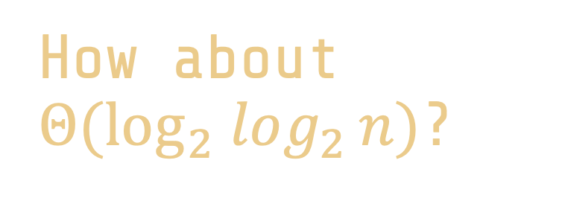
How about $Θ(\log_{2} log_{2}{n})$?
Image by Extravis_Marketing from Pixabay
English dictionary
1 word per second
250 000 words
4 seconds
500 000 words
4 seconds

Slide 24
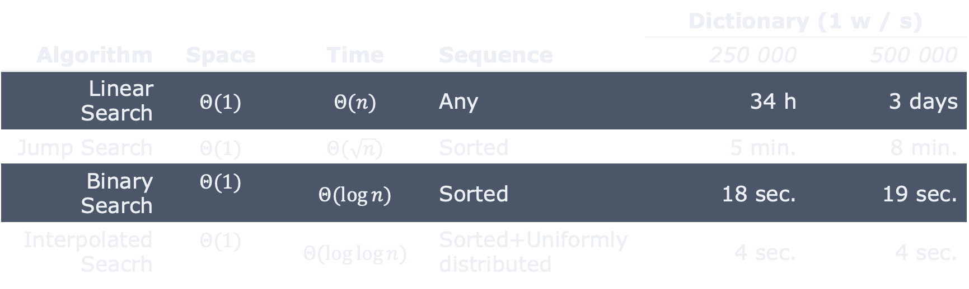
Recap
 |  |  |  | Dictionary (1 w / s)
Algorithm | Space | Time | Sequence | 250 000 | 500 000
Linear Search | $$Θ(1)$$ | $$Θ(n)$$ | Any | 34 h | 3 days
Jump Search | $$Θ(1)$$ | $$Θ(\sqrt{n})$$ | Sorted | 5 min. | 8 min.
Binary Search | $$Θ(1)$$ | $$Θ(\log{n)}$$ | Sorted | 18 sec. | 19 sec.
Interpolated Seacrh | $$Θ(1)$$ | $$Θ(\log{\log{n)}}$$ | Sorted+Uniformly distributed | 4 sec. | 4 sec.

Slide 25
Questions, Comments, or Ideas?
Franck Chauvel
Axbit & NTNU
franck.chauvel@gmail.com

Slide 26
References
Jump Search
Shneiderman, Ben. "Jump searching: A fast sequential search technique." Communications of the ACM 21, no. 10 (1978): 831-834.
Interpolated Search
Perl, Yehoshua, Alon Itai, and Haim Avni. "Interpolation search—a log log N search." Communications of the ACM 21, no. 7 (1978): 550-553.

Slide 27
Run-length Encoding (RLE) Lab Session (continued)
list “runs” with their length
Implement:
convertion
insertion
deletion
search
compression ratio?
1 run
input array
1
1
3
4
5
6
6
6
6
6
3
3
2 x 1
1 x 4
5 x 6
2 x 3
1 x 3
1 x 5
2
1
1
3
1
4
1
5
5
6
2
3
output array

